Slide 1
Introducing

Slide 2
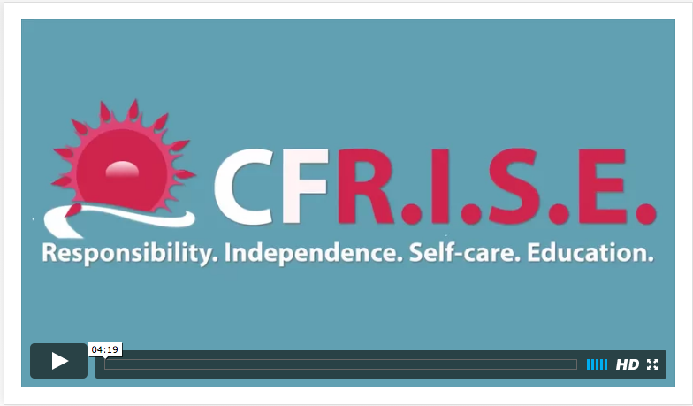
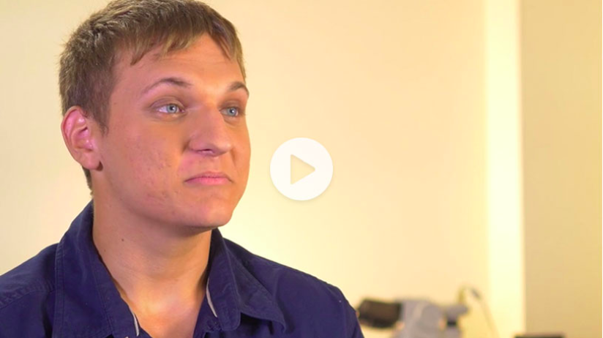

Slide 3
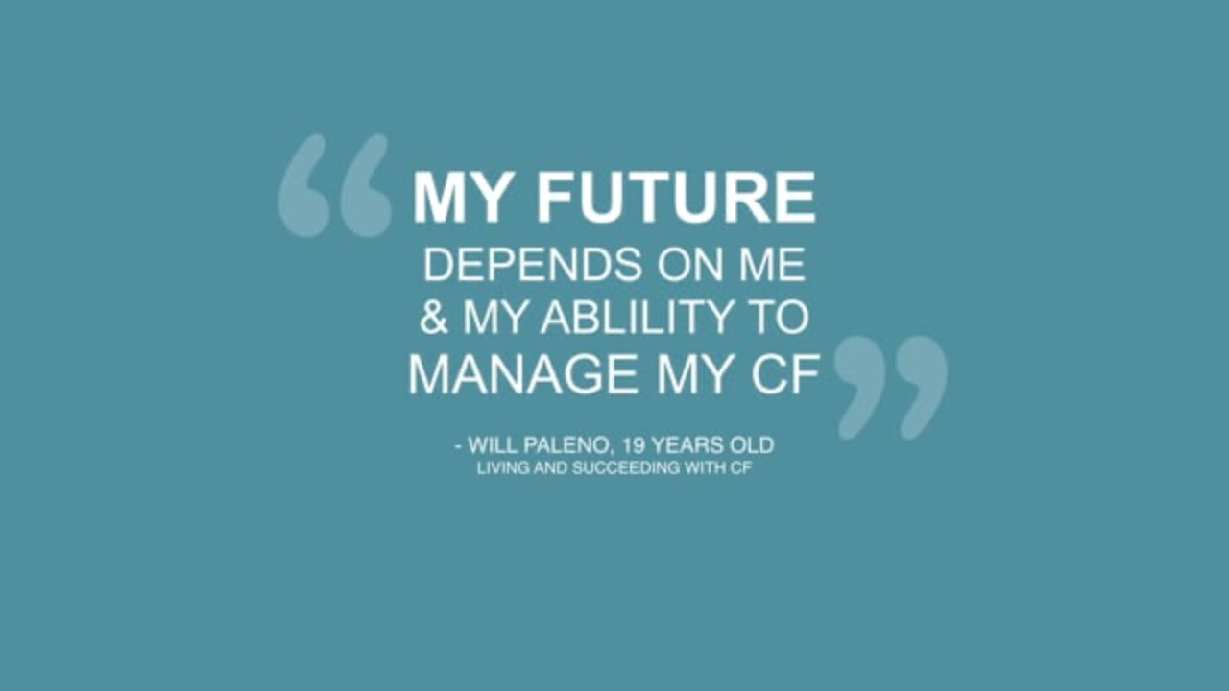

Slide 4
CF R.I.S.E. Program Overview
(Responsibility. Independence. Self-care. Education.)
Help prepare and empower people with CF aged 10-25 to transition to adult care
Identify areas for improvement in knowledge and ownership of CF self-care skills
Help to facilitate communication between people with CF & their caregivers as well as with their pediatric & adult care teams
‹#›

Slide 5

“Transitioning from pediatric to adult care is a big change, you think you know exactly what it means to take care of yourself until you realize you’re on your own. It’s overwhelming but programs like this help!”
– CF R.I.S.E. User, age 24
1. Spark Healthcare data, October 2018

Slide 6
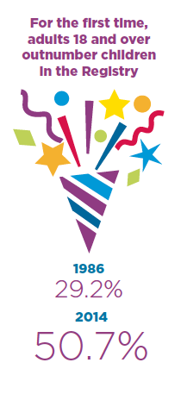
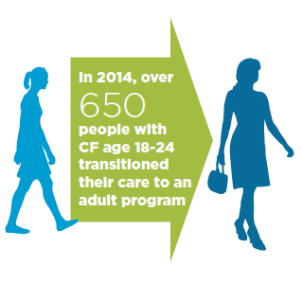
Transition & Transfer
Adolescence and emerging adulthood is a critical time for patients to transition to caring for themselves¹
Gaps in transfer and transition-related clinical care have been studied and identified²
  No consistent or standardized approach to transition nationally³
A growing recognition that we need to “do more” to effectively transition CF patients into adulthood⁴
Sources:
1. Cystic Fibrosis Foundation Patient Registry: 2014 Annual Data Report. Bethesda, MD: Cystic Fibrosis Foundation; 2014.
2. Flume PA, Taylor LA, Anderson DA, Gray S, Turner D. Transition programs in cystic fibrosis centers: perceptions of team members. Pediatr Pulmonol. 2004;37(1):4-7.
3. Parker HW. Transition and transfer of patients who have cystic fibrosis to adult care. Clin Chest Med. 2007;28(2):423-432.
4. McLaughlin, Suzanne Elizabeth, et al. Improving Transition From Pediatric to Adult Cystic Fibrosis Care: Lessons From a National Survey of Current Practices. Journal of the American Academy of Pediatrics, Dec 2008.

Slide 7
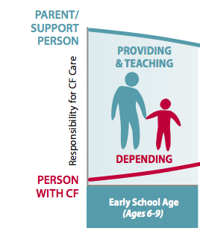
A Transfer of Leadership
Learning to balance the challenges of growing up with CF takes time and planning
This chart shows the evolving role of a Child/Young Adult and Parent/Support Person as the person with CF ages

Slide 8
Transition Advisory Council (TAC)
CF R.I.S.E. was developed in collaboration with a multidisciplinary team of CF experts
Physicians
Tara Barto, MD, Baylor College of Medicine (pediatric & adult)
Patrick Flume, MD, Medical University of South Carolina (adult)
Craig Lapin, MD, Connecticut Children’s Hospital (pediatric)
Charles McCaslin, MD, Helen DeVos (pediatric)
Samya Nasr MD, CPI University of Michigan (pediatric)
H. Worth Parker, MD, Dartmouth-Hitchcock Medical Center (pediatric & adult)
Hossein Sadeghi, MD, Cystic Fibrosis Center Columbia University Medical Center (pediatric)
Greg Sawicki, MD, Boston Children’s Medical Center (pediatric)
Jonathan Spahr, MD, University of Pittsburgh School of Medicine (pediatric)
Center Coordinator
Diane Acquazzino, BS, University of Nebraska Medical Center (pediatric)
Psychologists
  Alexandra Quittner, PhD, University of Miami (pediatric)
  Kristin Riekert, PhD, Johns Hopkins University (pediatric & adult)
Nurse Practitioner
Elizabeth Bryson, MSN, PPCNP-BC, CS, Nurse Practitioner, Akron Children's Hospital (pediatric)
Nurse
Mary Helmers, RN, BSN, Lucile Packard Children's Hospital at Stanford University (pediatric)
Social Workers
Anne Daggett, MSW, LCSW, St. Luke’s Cystic Fibrosis Center of Idaho (pediatric)
Kecia Nelson, MSW, LCSW, University of Missouri Children's Hospital (pediatric & adult)
Child Life Specialist
Carla Hart, MS Ed, St. Luke’s Cystic Fibrosis Center of Idaho (pediatric)
Parent
Lisa Greene, MA, Certified Family Life Educator, Certified Parent Coach, Certified Positive Discipline Educator

Slide 9
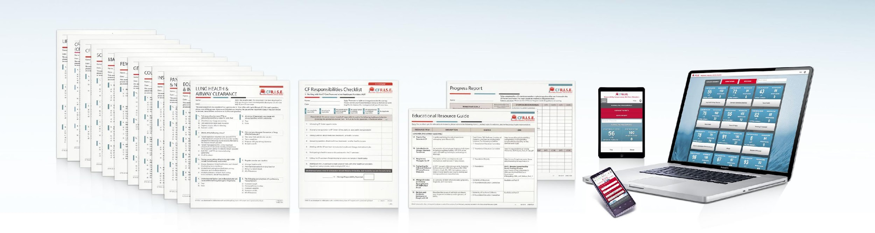
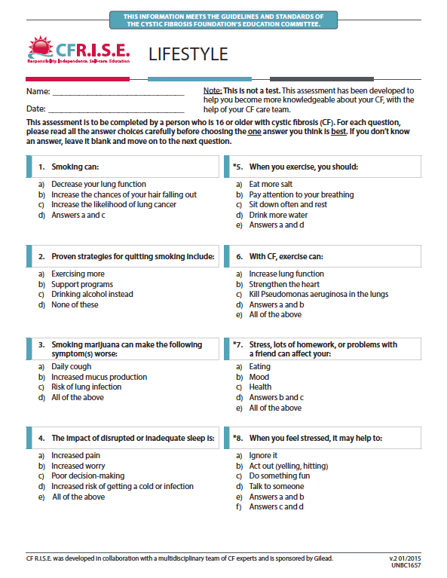
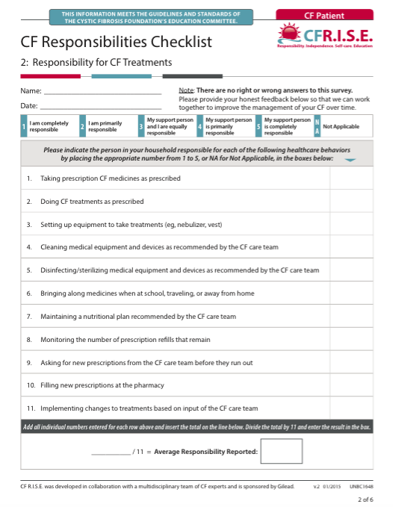
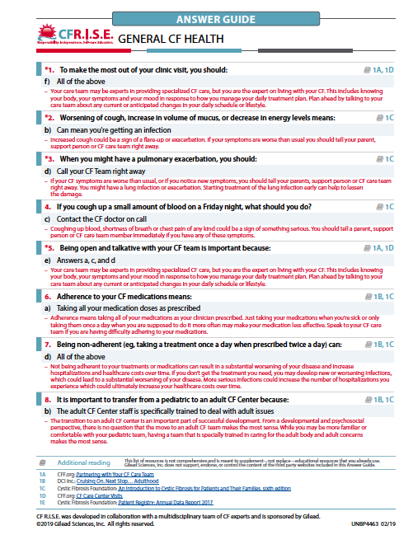
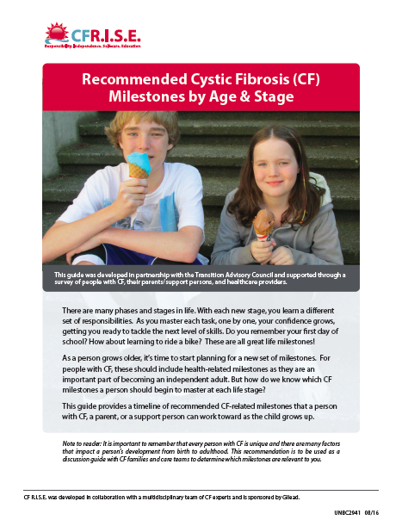
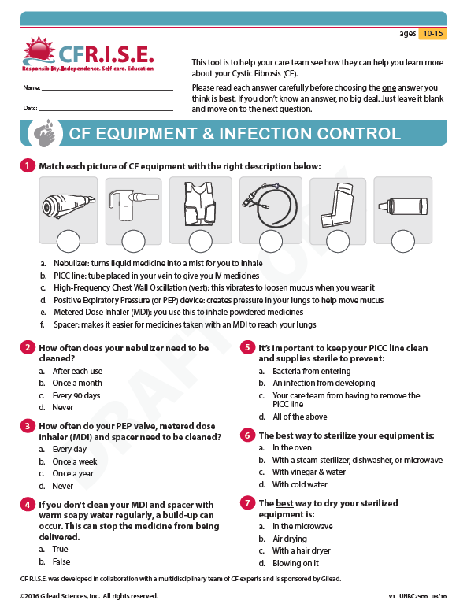
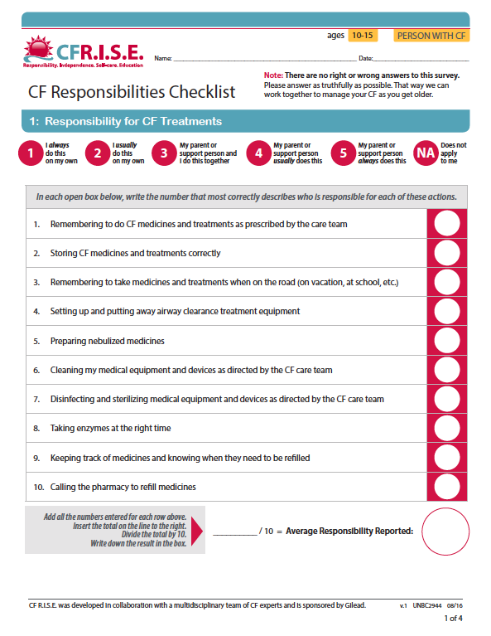
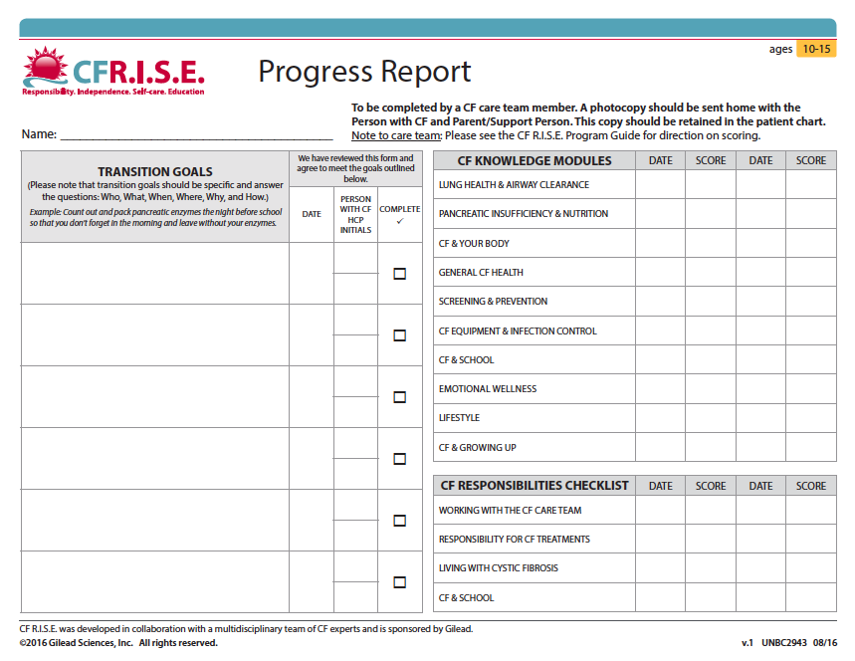
CF R.I.S.E. Tool set
THESE TOOLS MEET THE GUIDELINES AND STANDARDS OF THE CF FOUNDATION’S EDUCATION COMMITTEE.
CFRISE.com
CF Milestones by Age & Stage
CF Knowledge Assessments
Responsibilities
Checklists
Progress Reports &
Answer Guides
  Digital Portal can be accessed on a desktop, tablet, or mobile format
Tools are available in Print format as well as on the Interactive Digital Portal
‹#›

Slide 10
“It helped me understand stuff I didn't know and get a better understanding of things I did know.”
- CF R.I.S.E. User
1. Spark Healthcare data, 2016

Slide 11
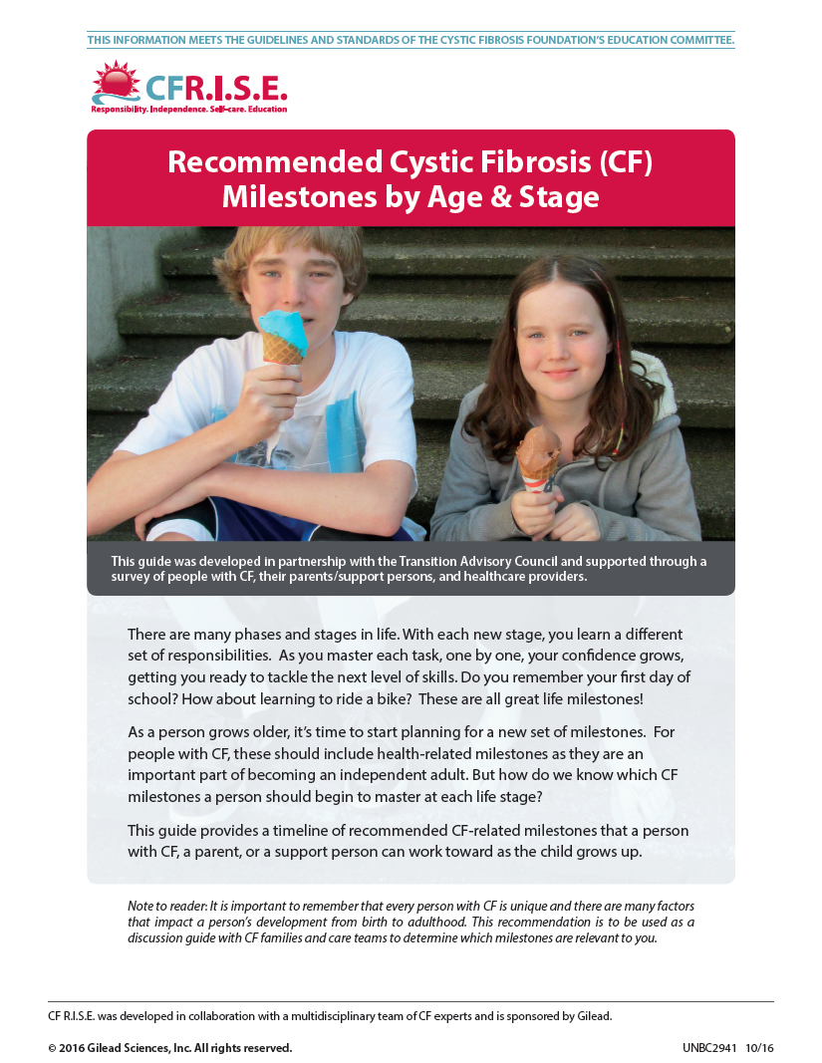
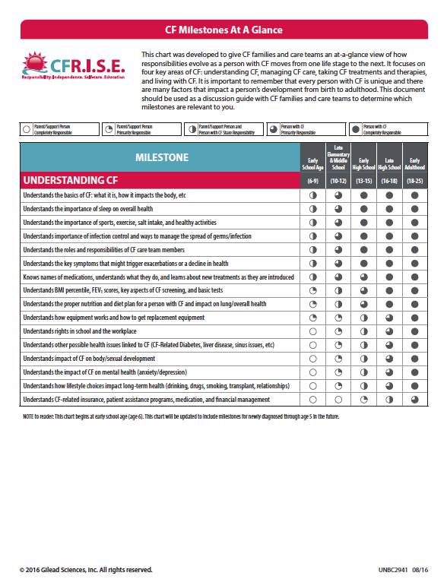
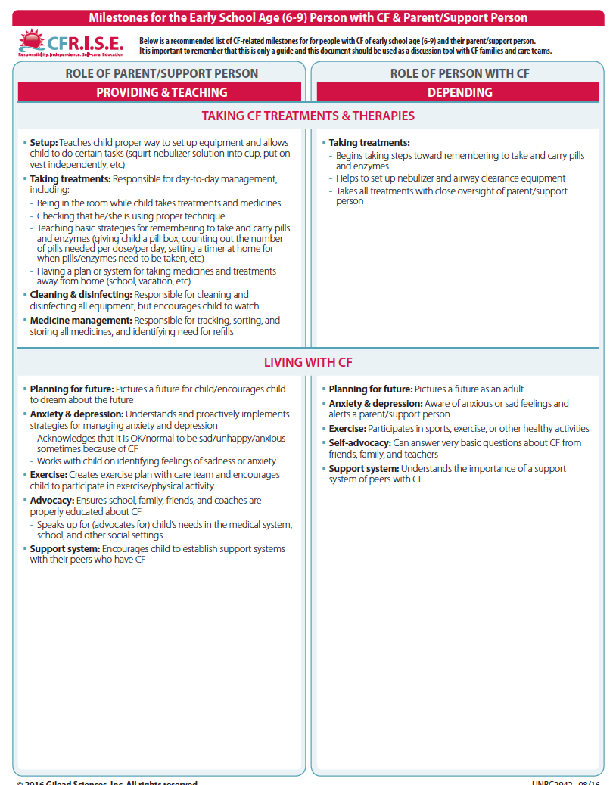
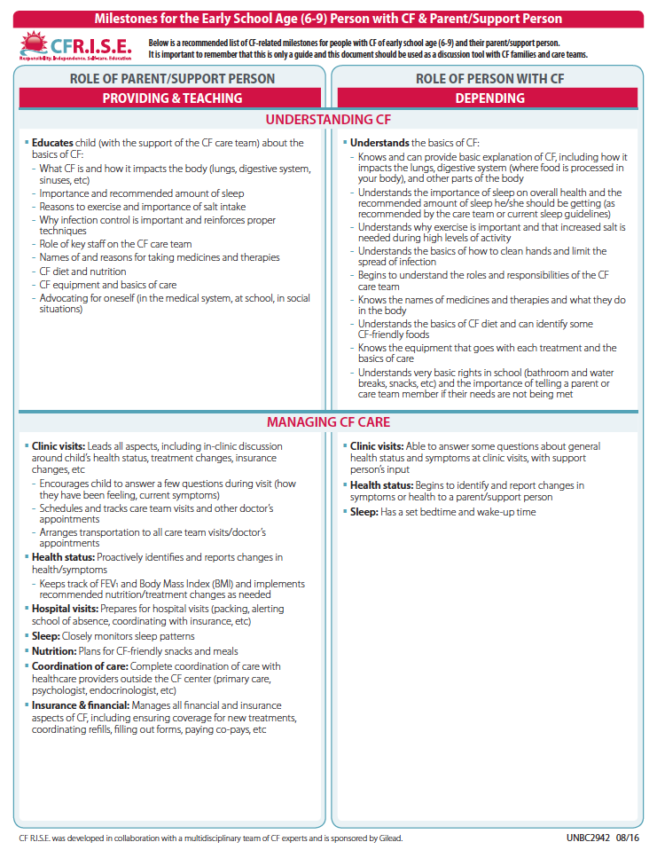
CF Milestones by Age and Stage
Introduces the need for a gradual, purposeful transition of responsibility from support person to person with CF over time
Focuses on milestones in four areas of CF care:
  Understanding CF
  Managing CF Care
  Taking CF Treatments & Therapies
  Living with CF
Includes an “At A Glance” chart of milestones, as well as more specific guidance by age and stage

Slide 12
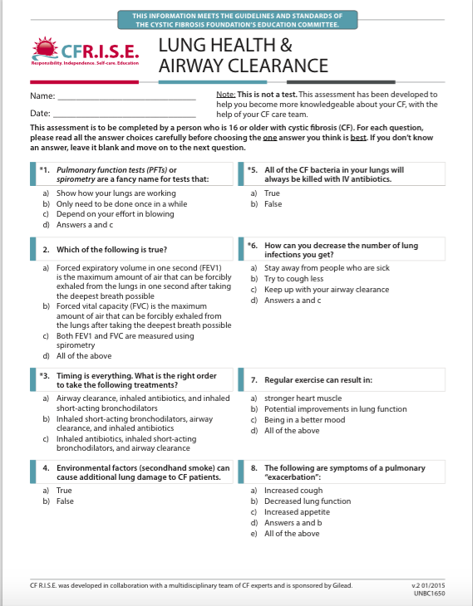
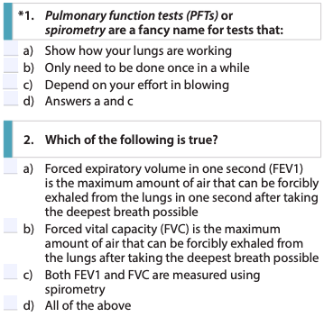
CF Knowledge Assessments
LUNG HEALTH &
AIRWAY CLEARANCE
Knowledge Assessment Topics
  General CF Health
  Lung Health and Airway Clearance
  Pancreatic Insufficiency & Nutrition
  Screening & Prevention
  Equipment & Infection Control
  Lifestyle
  CF & School
  Emotional Wellness
  CF & Your Body
  CF & Growing Up
  CF Liver Disease
  CF-Related Diabetes
      Sexual Health
      Insurance & Financial
      College & Work
10-15 yo
16-25 yo

Slide 13
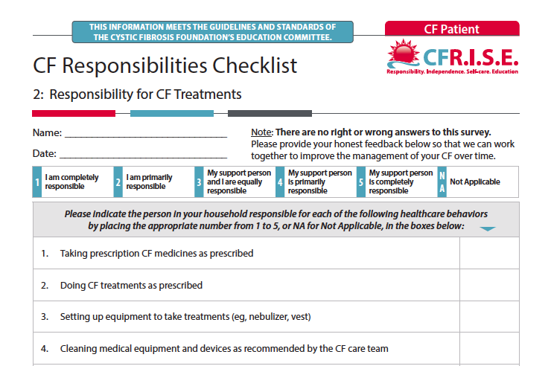
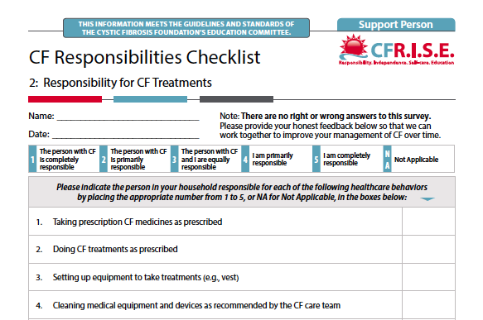
Responsibilities Checklists for Persons with CF & Support Person
PERSON WITH CF
CHECKLIST
SUPPORT PERSON
CHECKLIST
CF Responsibilities Checklists help persons with CF identify aspects of their care and where they can take more ownership
Completed by person with CF and support person (ex: parent, spouse, significant other)

Slide 14
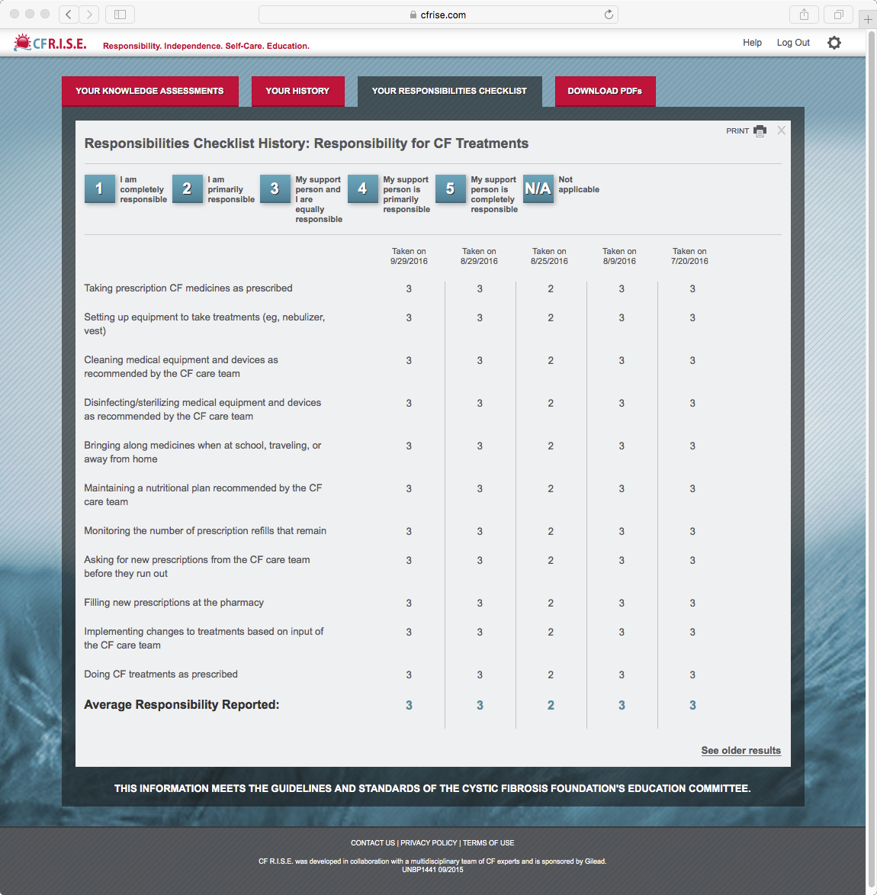
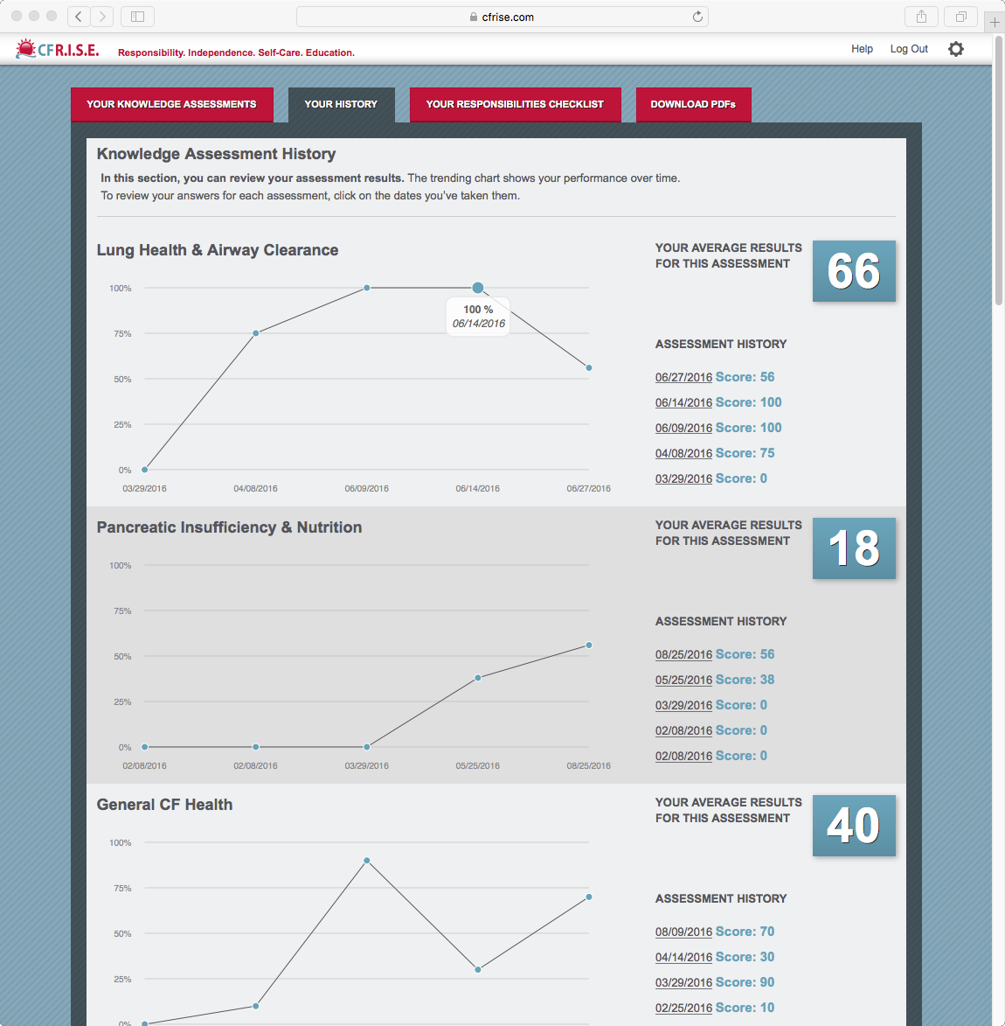
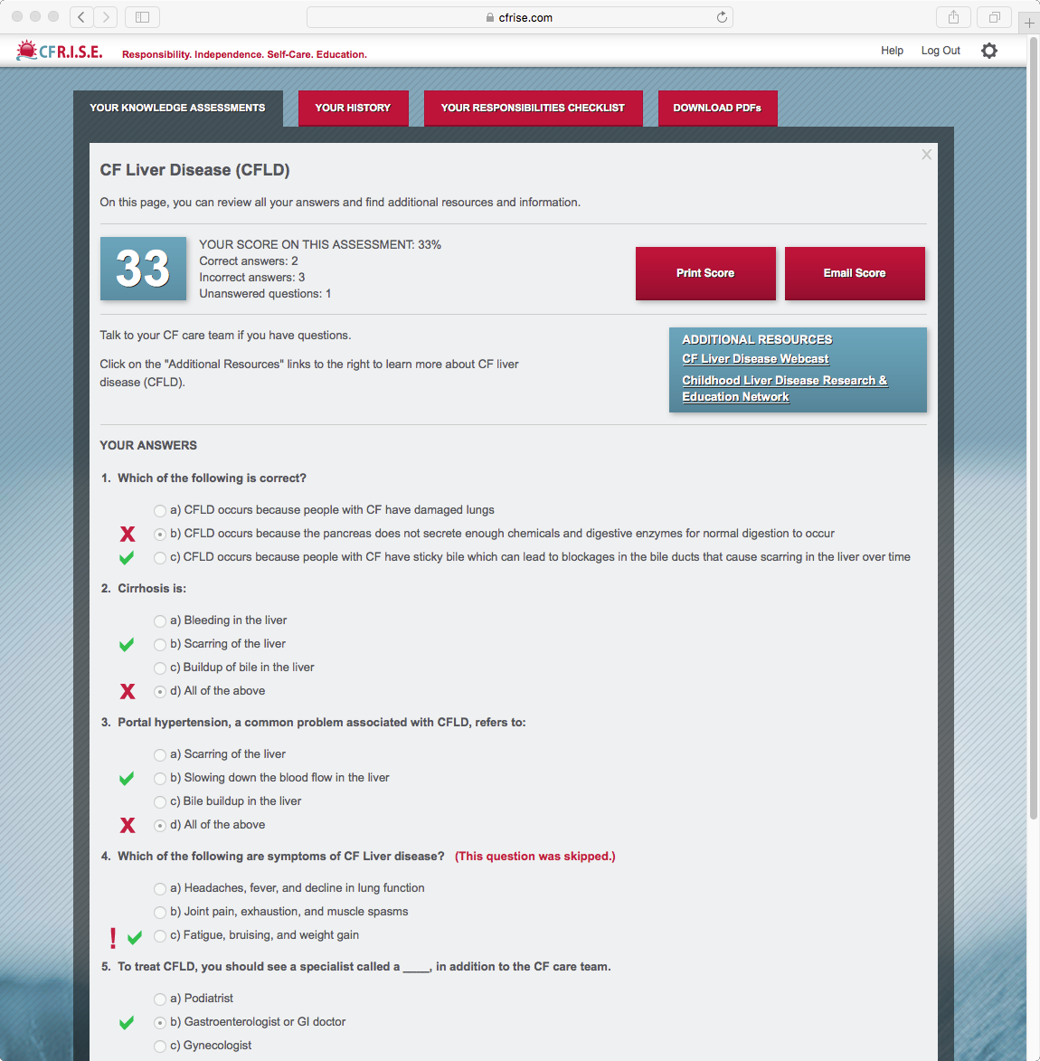
CFRISE.com Website
KNOWLEDGE ASSESSMENTS
  Direct links to educational resources relevant to gaps
  Option to email results
HISTORY OF RESULTS
  History of knowledge assessments & responsibilities checklists
  Track results over time
RESPONSIBILITIES CHECKLISTS
  Identify level of responsibility around CF between patient and support person
Why Go Digital?
Access the site from your desktop, tablet, or mobile format
Log in at home after clinic
Access your results and educational materials
Review your history of results
‹#›

Slide 15
“...It is important to understand why you do certain things. You are more likely to do things if you understand why.”
- CF R.I.S.E. User
1. Spark Healthcare data, 2016

Slide 16
Protecting Your Privacy
Each person with CF personally registers for the Website
    First Name, gender, email address, and birth date
    Must be 13 or older to register
  Persons with CF under 18 require a parent/guardian’s consent
Clinic code ensures that only you and your care team have access to your information
Privacy Compliance & Informed Consent
    Data is safeguarded with security tools including a user ID and password
    Data encryption for all personal information

Slide 17
CF R.I.S.E. Process
Introduction to Program CF Care team discusses CF R.I.S.E. program to the person with CF and their family
Implement Transition Goal
(contact care team if you have questions)
Enroll/Login to CFRISE.com
(can be accessed via smartphone, tablet, laptop or desktop computer)
Take Home a Copy of Your Progress Report
(place copy in your chart for reference at next visit)
Complete CF Knowledge Assessment(s) and/or Responsibilities Checklist(s)
(as directed by the care team)
Discuss & Set Measurable Transition Goal(s)
(capture goal on Progress Report and initial to indicate commitment)
Review Results and Discuss Educational Needs
(track results on the Progress Report)

Slide 18

What’s Next?
Ask your care team for more information and how to register on CFRISE.com today!

Slide 19
THANK YOU!
UNBC6500 07/19

